Slide 1
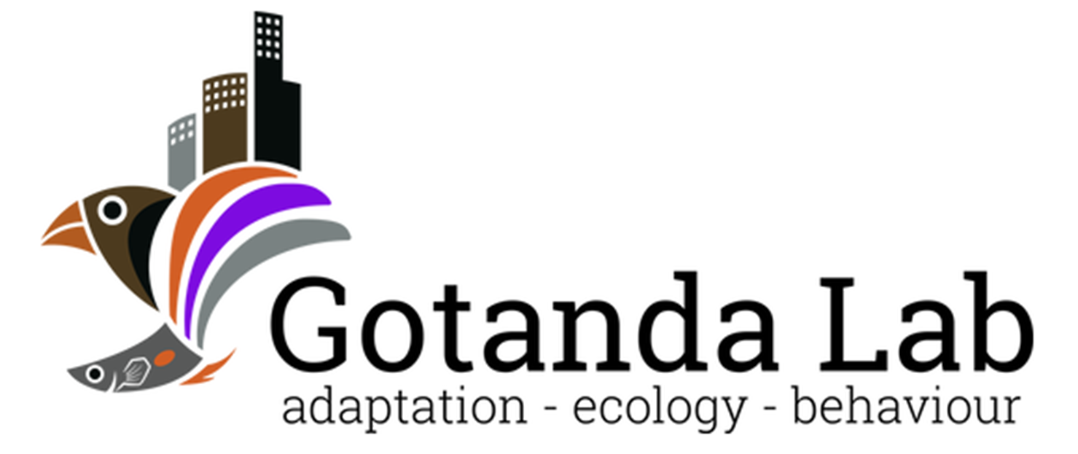

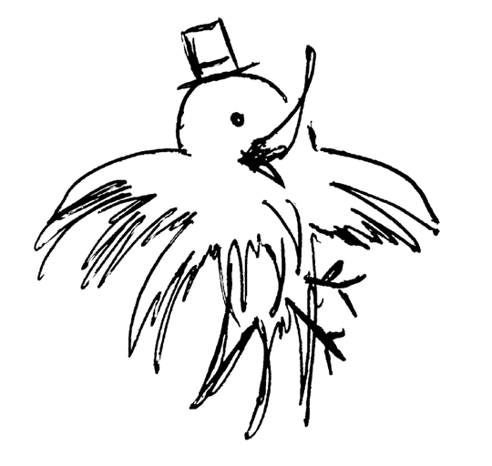
Heads Up!
Social Vigilance Behavior in American Crows
Alex Popescu, Dr. Anne B. Clark, Dr. Kiyoko M. Gotanda
GRaD 2023
Brock University

Slide 2
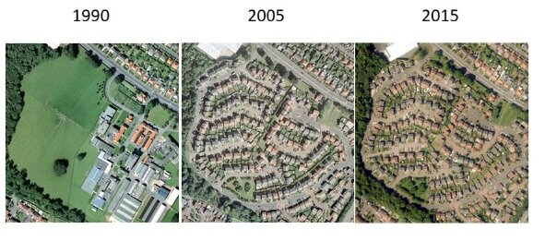
Urbanization
The shift in human population from rural to urban areas
An example of urbanisation in Edinburgh 1990 to 2015 Credit: CEH
Notes:
~55% of world population currently concentrated in urban areas, with the UN projecting that number to climb to 68% by 2050.

Slide 3
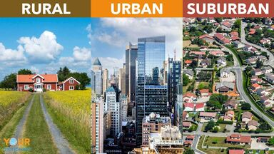
Urbanization
Leads to changes in the environment:
↓ Lines of sight
↑ Human-animal interactions
↓ Green spaces
Has negative effects on many species; associated with the global loss of biodiversity
https://examples.yourdictionary.com/identifying-difference-between-rural-urban-suburban
Kowarik I. 2011 Novel urban ecosystems, biodiversity, and conservation. Environ. Pollut. 159

Slide 4
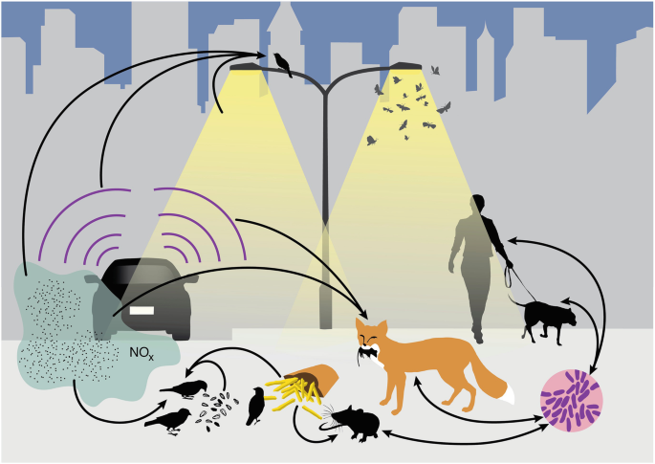
Can species be successful in cities?
Yes!*
* Will depend on species’ traits
Advantageous traits:
Adaptability
A generalist nature
An omnivorous diet
Intelligence
Isaksson, C. (2018). Impact of Urbanization on Birds. In: Tietze, D. (eds) Bird Species
Patankar S et al. 2021 Which Traits Influence Bird Survival in the City? A Review. Land 10
Notes:
Modified diet
↑ Interspecific aggression
↑ Tolerance of risks
↑ Tolerance of human proximity

Slide 5
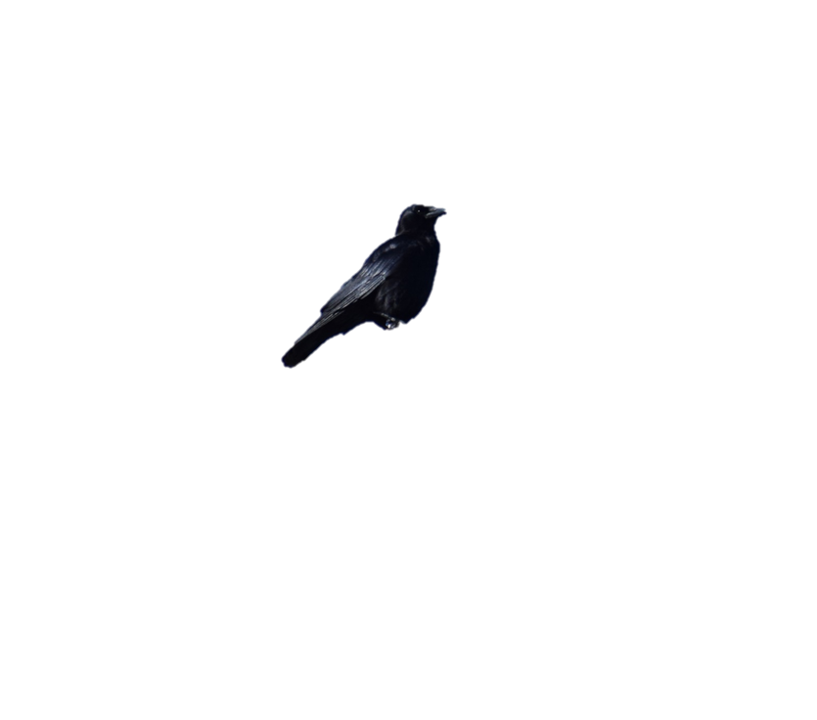
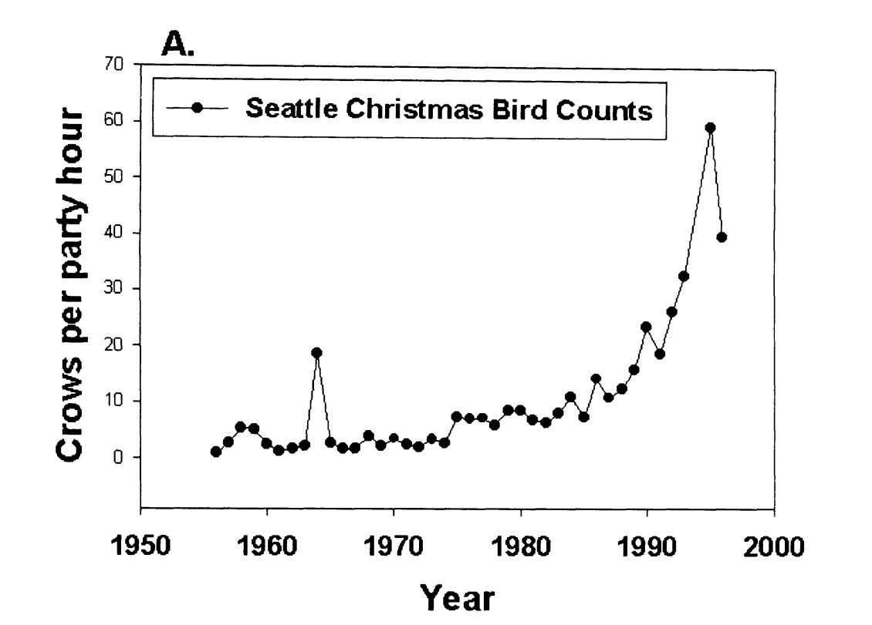
American crows in urban areas
Why are American crows so successful in urban areas?
Crows spotted per hour
Marzluff et al.(2001). Avian Ecology and Conservation in an Urbanizing World || Causes and consequences of expanding American Crow populations.
Notes:
We picked the crow bc… Talk about G. env

Slide 6
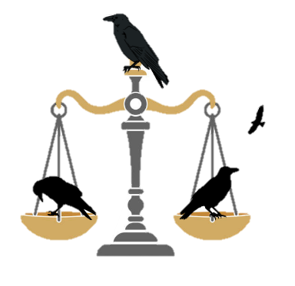
Vigilance and social foraging behavior
A trade-off between vigilance and foraging efficiency
Too much is like not enough
Notes:
Prediction:
Hold your audience’s hand for the predictions. Be explicit!

Slide 7
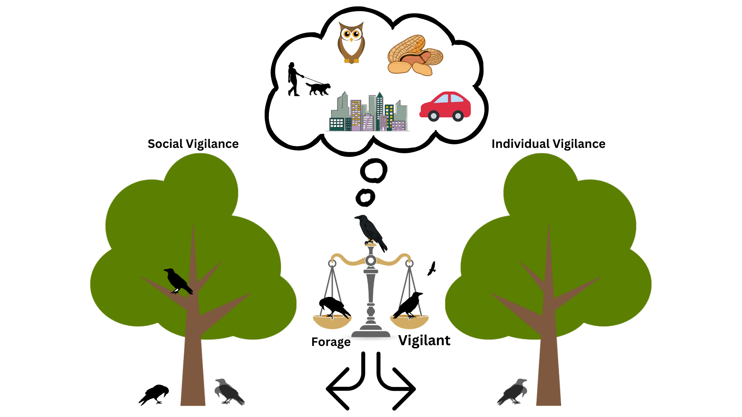
Sentinels
The sentinel ensures the protection of foraging group-members through constant vigilance.
Costly behavior to the sentinel, but very beneficial to foragers.
Social Foraging
Individual Foraging
Notes:
Shorten! Remove too much info about sentinels & focus on urbanization/G. Env

Slide 8
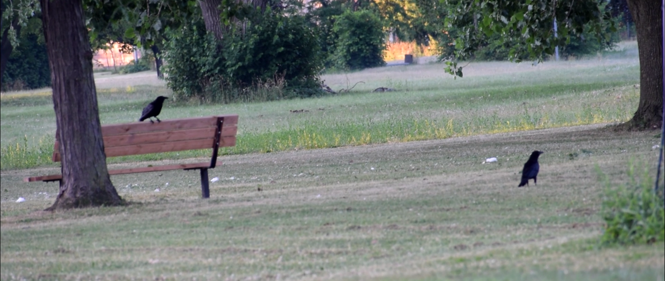
Sentinels
The presence of a sentinel is expected to reduce the vigilance of foragers.
Notes:
Remove prediction about sentinels, just show what sentinels look like.

Slide 9
My objective
Determine if an individual’s foraging vigilance affected by the presence of a sentinel and the environment in which it forages in.
The modified use of social behaviors is understudied.
Could explain, in part, the success of American crows in urban areas.
Notes:
Update this and add B-WW-SB. Be explicit!

Slide 10
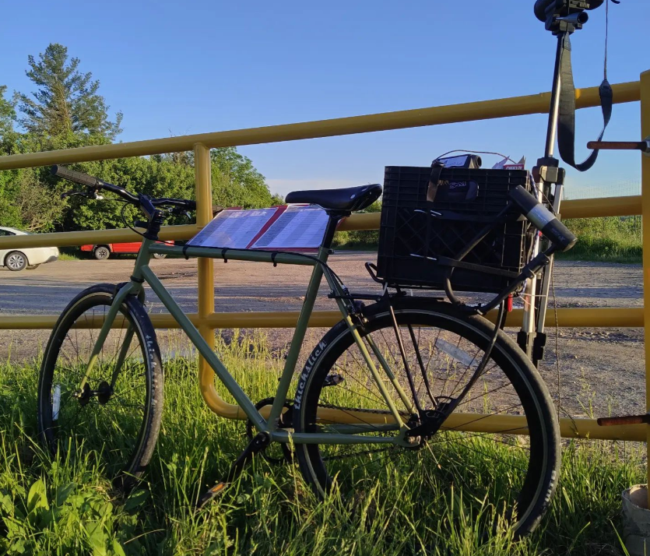
Methods
Testing sites were selected through a community science initiative: Crowkémon Go
Notes:
Explain verbally WHY you baited the sites.

Slide 11
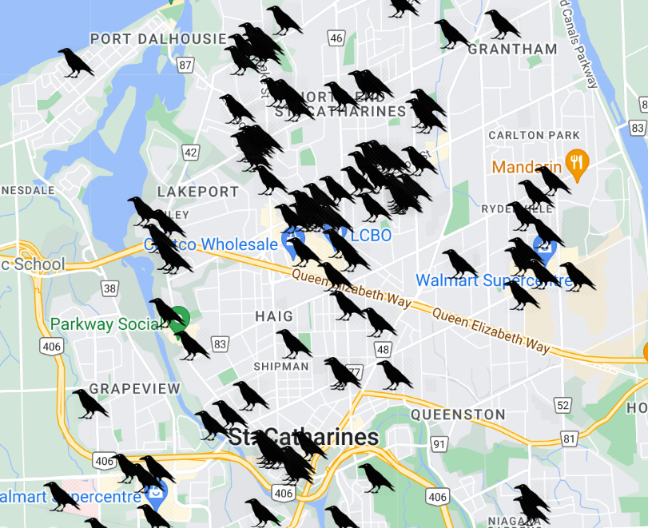
Crowkemon Go
Started in Jan 2022
Participants across the Niagara region were invited to mark the locations of crows.
Notes:
Be concise!

Slide 12
Methods
Testing sites were selected through a community science initiative: Crowkémon Go
Foraging bouts were video recorded from a distance and coded at a later date
Notes:
Armed with friends, cameras and bicycles, we bravely went out at 6am to chase crows!
Remove bait

Slide 13
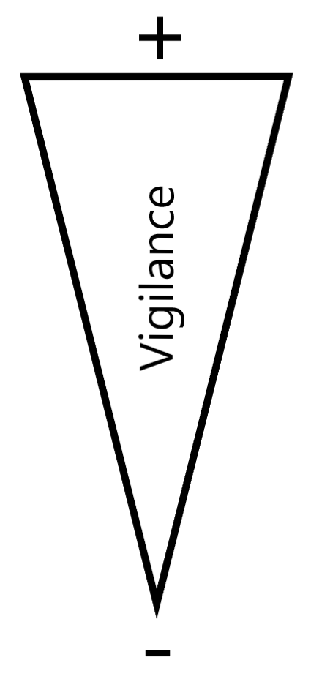

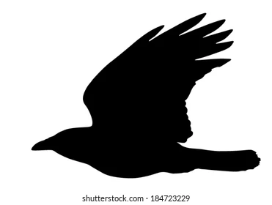

Methods
Alert
Moving
Foraging
Notes:
Can’t tell what the crow is looking at when moving (verbal)

Slide 14
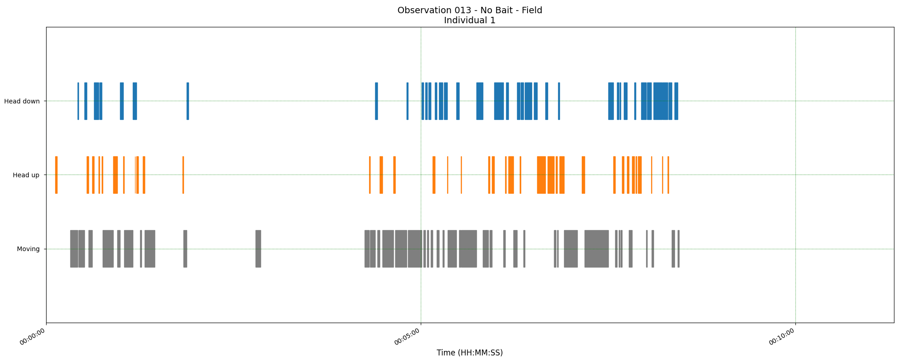
Methods
Three measurements:
The proportion of ‘foraging time’ allocated to each behavior
Duration of behavioral instances
Peck rate
Foraging
Alert
Moving
Time
Notes:
***Briefly explain & put arrows to show what each measurement is ***
**DO NOT MENTION BORIS!!!**

Slide 15
Research questions
 | Green Areas | Commercial Areas
Allocation of time to behaviors in foragers | Foraging ↑ Alert ↓ | Foraging ↓ Alert ↑
Duration of behavioral instances | Foraging ↑ Alert ↓ | Foraging ↓ Alert ↑
Foraging efficiency of foragers | Peck rate ↓ | Peck rate ↑
Likelihood of a sentinel being present | ↑ | ↓
Notes:
Remove right side of table, focus only on G.Env.

Slide 16
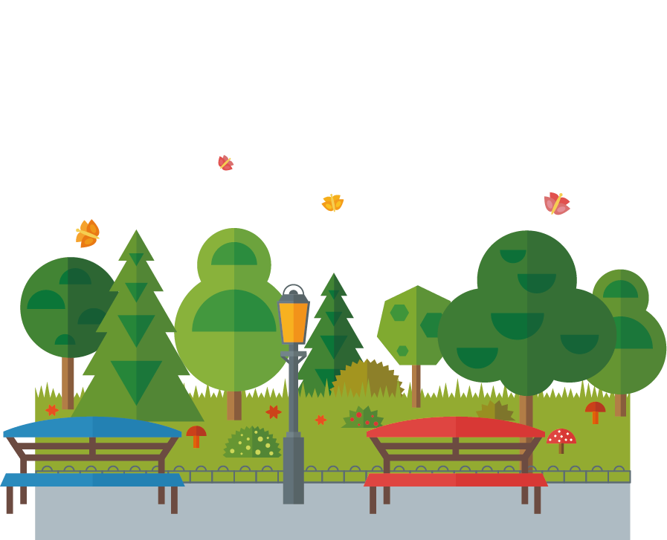

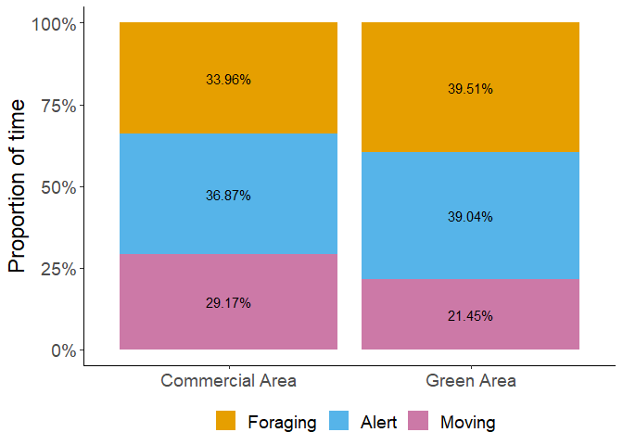

Proportion of time
No significant effects of generalized environment (p = 0.989)
If not the proportion, could it be the duration of bouts that change?
Notes:
Compare only across environment, remove sentinel presence/absence

Slide 17
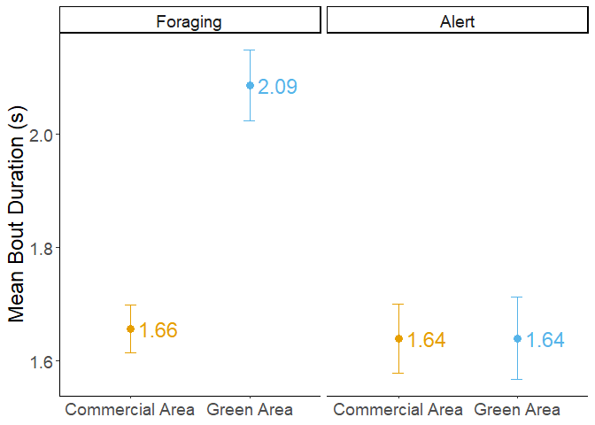
Bout Duration
Foraging:
- Increased duration in green areas (p=<0.001)
Alert:
- No effect of generalized environment (p=0.965)
Notes:
Condense with previous slide, remove sentinel presence!
Remove bait

Slide 18
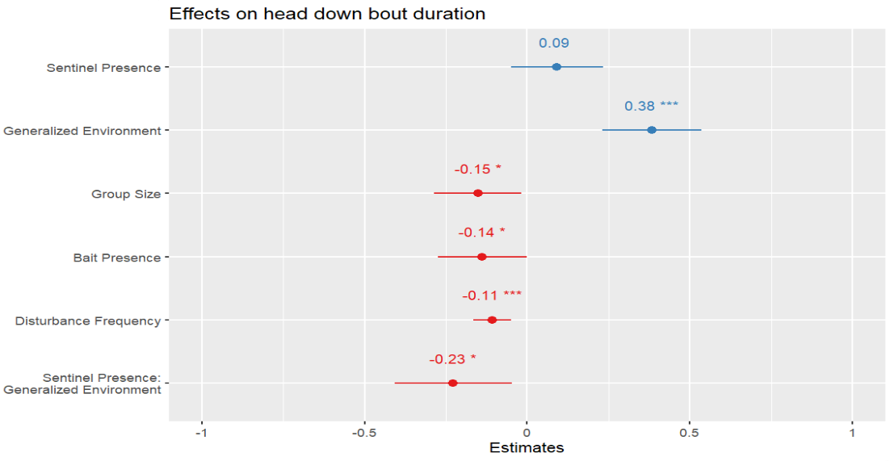
Foraging
Definitely some interesting results!
Foraging bout ↑ in Green areas = ↑ handling + searching time
Notes:
Keep, but shorten ramblings.
Remove urgency. Too deep.
Remove bait, Don’t have time to talk about it. Can ignore.

Slide 19
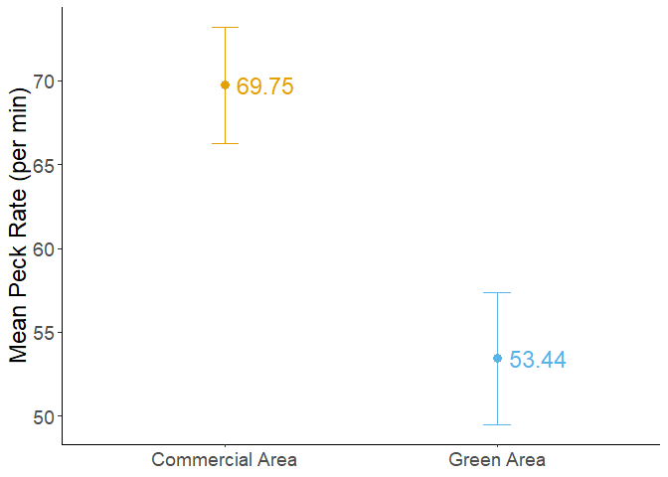
Peck rate
The generalized environment had a marginally significant effect (p = 0.076)
Notes:
Remove sentinel presence, keep only G.Env & make comparisons across.
Remove bait

Slide 20
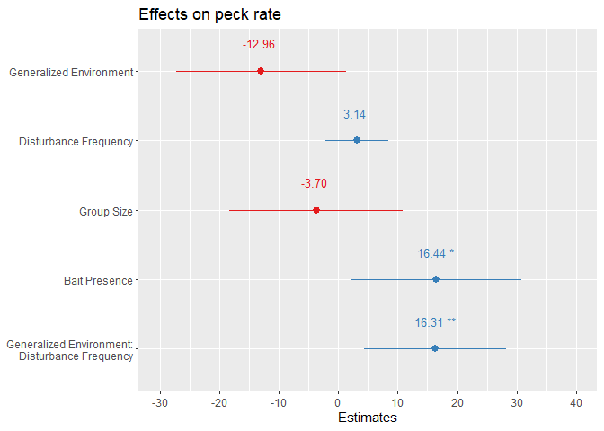
Peck Rate
More interesting results!
Green areas had a lower peck rate than commercial areas.

Slide 21
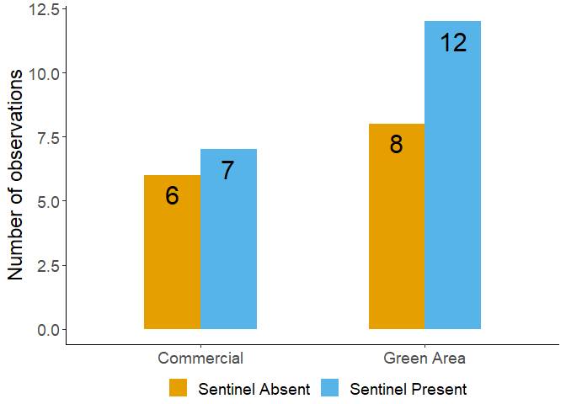
Likelihood of sentinel presence
No effect of generalized environment!
Notes:
Make text larger, give y-axis label (NOT ‘count’)
Consider removing if prez too long.

Slide 22
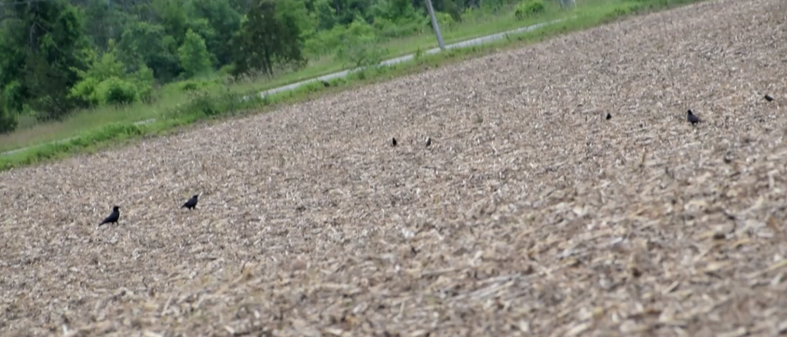
Some caveats
It is impossible to tell what the crows are looking at when being alert:
Looking for threats and predators
Other species
Other crows
Did they find something?
Notes:
Add image to take up some of the white space before putting the big image up.

Slide 23
Some caveats
Not just generalized environment! I’m also looking at the effects of:
Sentinel presence
Resource concentration (simulate trash/anthropogenic food)
Disturbance frequency
Notes:
Add image to take up some of the white space before putting the big image up.

Slide 24

Research questions
 | Green Areas | Commercial Areas
Allocation of time to behaviors in foragers | Foraging ↑ Alert ↓ | Foraging ↓ Alert ↑
Duration of behavioral instances | Foraging ↑ Alert ↓ | Foraging ↓ Alert ↑
Foraging efficiency of foragers | Peck rate ↓ | Peck rate ↑
Likelihood of a sentinel being present | ↑ | ↓
No effect
Foraging ↑
Foraging ↓
No effect
Notes:
Remove right side, focus only on G. Env.
Be quick about it, no need to repeat, consider having the table reappear between results slides.

Slide 25
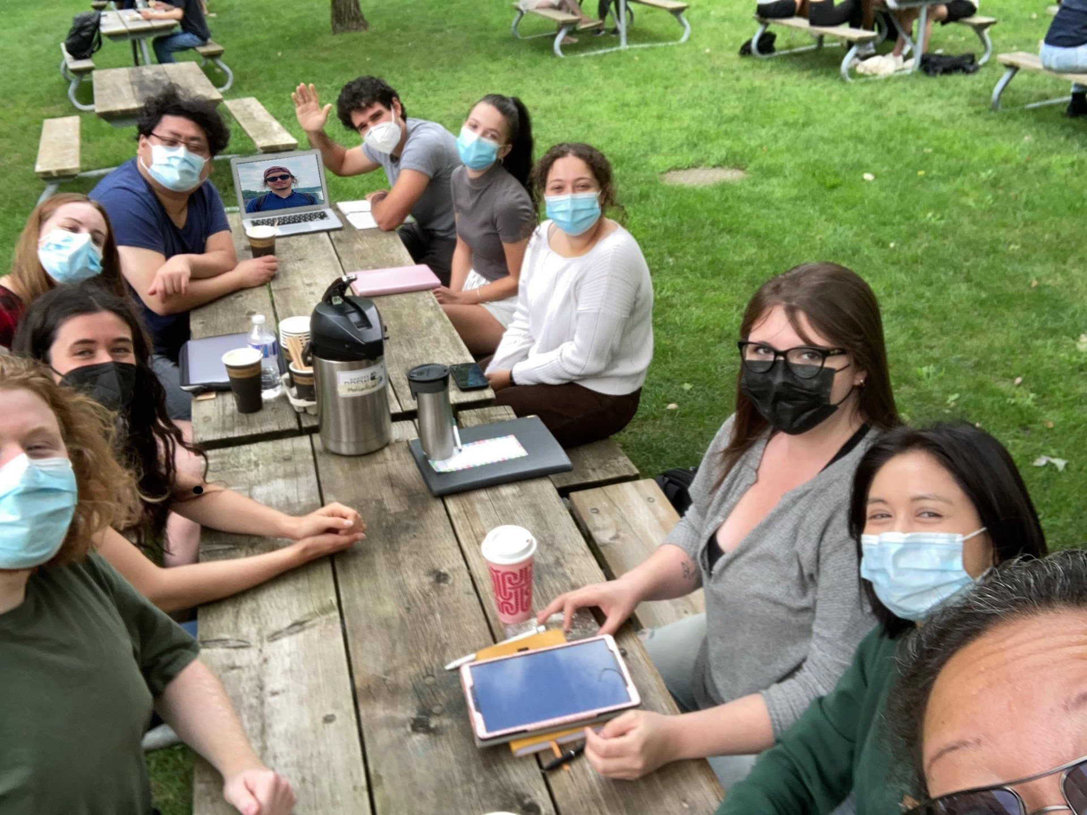

Acknowledgements
My supervisors: Dr. Kiyoko Gotanda, Dr. Liette Vasseur, Dr. Anne Clark
The Gotanda Lab
My family and friends
Notes:
Funded by Brock, no need to mention explicitly. Thank funding sources at a defense (which this isn’t)

Slide 26
General feedback
Only compare environments, remove sentinel presence entirely
Re-do graphs in R to reflect ^^^
MAKE SHORTER!!! – Cut back even more on theory to talk more about the results.
Less details, more punchlines -> Tie into B-WW-SB *Define*
Explain the results briefly, talk about them afterwards (if anyone has questions)
Stop repeating yourself, unless necessary
Update website if you’re going to have the QR code (might not have time)

